Slide 1
Chapter 3: Introduction to SQL

Slide 2
Nested Subqueries
SQL provides a mechanism for the nesting of subqueries. A subquery is a select-from-where expression that is nested within another query.
The nesting can be done in the following SQL query select A₁, A₂, ..., A_{n} from r₁, r₂, ..., r_{m} where P
as follows:
From clause: r_{i} can be replaced by any valid subquery
Where clause: P can be replaced with an expression of the form:
B <operation> (subquery)
B is an attribute and <operation> to be defined later.
Select clause:
A_{i} can be replaced be a subquery that generates a single value.

Slide 3
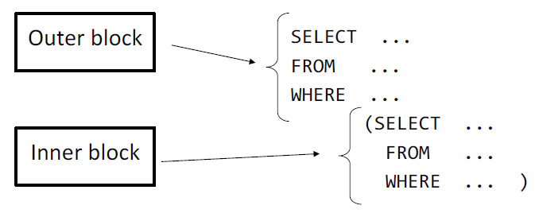
Nested Subqueries

Slide 4
Set Membership
Find courses offered in Fall 2017 and in Spring 2018
Find courses offered in Fall 2017 but not in Spring 2018
select distinct course_id
from section
where semester = 'Fall' and year= 2017 and course_id in (select course_id
from section
where semester = 'Spring' and year= 2018);
select distinct course_id
from section
where semester = 'Fall' and year= 2017 and course_id not in (select course_id
from section
where semester = 'Spring' and year= 2018);

Slide 5
Set Membership (Cont.)
Name all instructors whose name is neither “Mozart” nor Einstein”
select distinct name
from instructor
where name not in ('Mozart', 'Einstein')
Find the total number of (distinct) students who have taken course sections taught by the instructor with ID 10101
Note: Above query can be written in a much simpler manner. The formulation above is simply to illustrate SQL features
select count (distinct ID)
from takes
where (course_id, sec_id, semester, year) in (select course_id, sec_id, semester, year
from teaches
where teaches.ID= 10101);

Slide 6
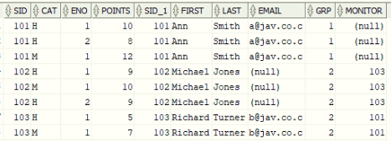

Set Membership (Cont.)
IN en situaciones es similar a INTERSECT y / o Join
NOT IN en situaciones es similar a MINUS
Liste los estudiantes que han presentado exámenes, esto es, tienen resultados
SELECT s.*
FROM
students s
WHERE
s.sid IN
(
SELECT sid
FROM results
)
SELECT *
FROM
results b,
students a
WHERE
a.sid = b.sid

Slide 7


Set Membership (Cont.)
IN en situaciones es similar a INTERSECT y / o Join
NOT IN en situaciones es similar a MINUS
Liste los estudiantes que NO han presentado exámenes, esto es, tienen resultados
SELECT s.*
FROM
students s
WHERE
s.sid NOT IN
(
SELECT sid
FROM results
)
SELECT sid
FROM students
MINUS
SELECT sid
FROM results;

